Slide 1
Homework
Write a client-side based web application that consists of a trash bucket and lots of trash items in the browser window. Implement the following functionality:
Drag trash items
Open the bucket when a trash item is being dragged over it and close when the trash is dragged out of the bucket, or is dropped in the bucket
To throw a trash item into the bucket, i.e. make it disappear from the browser window

Slide 2
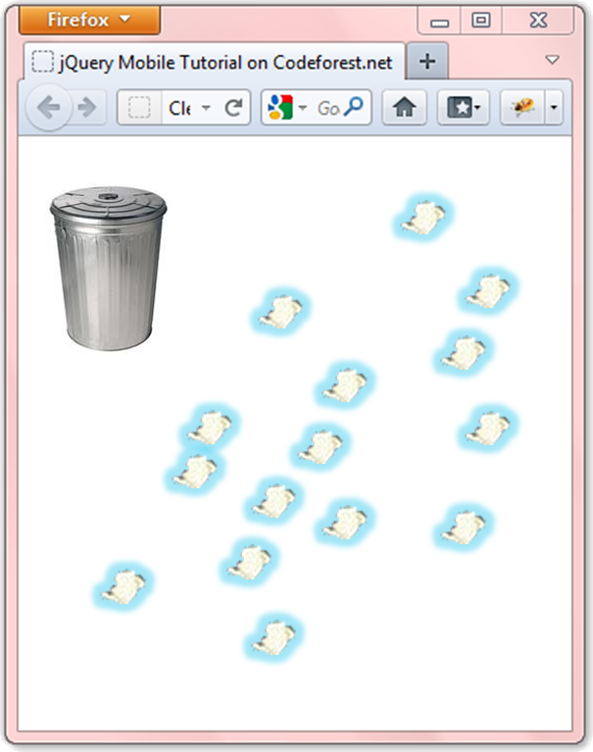
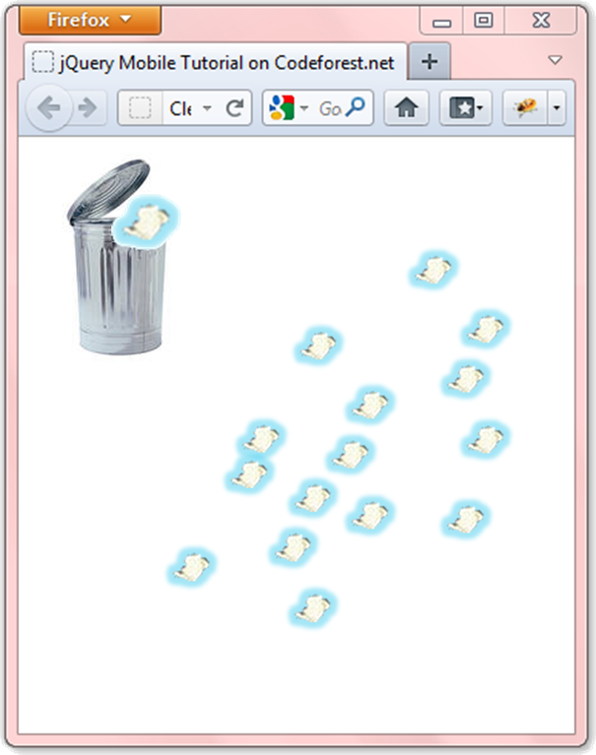
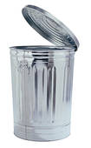

Homework (2)
With Drag
Clean the Trash example

Slide 3
Homework (3)
Using the exercise with the bucket implement functionality for high-score board
When the user cleans all the trash, he is asked for a nickname and his score is saved in the local storage
The score of the user is the time that took him to clean the trash
Implement a high-score board, that is visible on page load and shows the top 5 scores
The 5 users that cleaned the trash fastest
Create shiv/shim/polyfill to enable localStorage and sessionStorage in browsers that do not support them

Slide 4


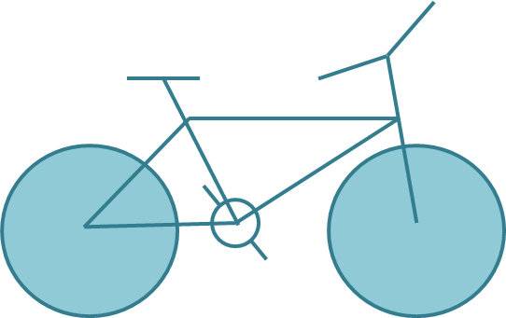
Homework (4)
Draw the following graphics using canvas:

Slide 5
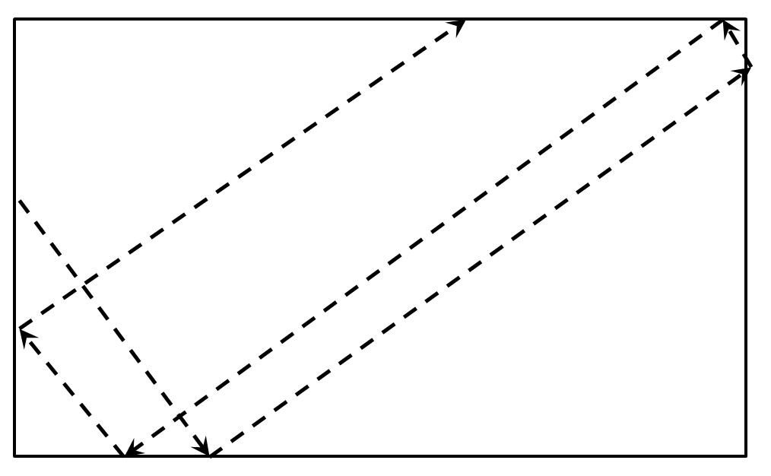
Homework (5)
Draw a circle that flies inside a box
When it reaches an edge, it should bounce that edge

Slide 6
Homework (7)
*Create the famous game "Snake"
The snake is a sequence of rectangles/ellipses
The snake can move left, right, up or down
The snake dies if it reaches any of the edges or when it tries to eat itself
A food should be generated
When the snake eats the food, it grows and new food is generated at random position
Implement the game using OOP and canvas
Implement a high-score board, kept in localStorage

